Slide 1
DIGITAL IMAGE PROCESSING

Slide 2
COURSE OUTCOMES(COs)
Identify the basic concepts of Image processing and compute the different transforms used in image processing.
Apply the different spatial and frequency domain methods for Image enhancement.
Use different techniques for Image segmentation.
Identify the different methods for Image compression.
Apply different morphological algorithms for image processing.

Slide 3
UNIT – I
Fundamentals of Image Processing and Image Transforms: Basic steps of Image Processing System, Sampling and Quantization of an image, relationship between pixels. Image Transforms: 2 D- Discrete Fourier Transform, Discrete Cosine Transform (DCT)
UNIT – II
Image Processing Techniques: Image Enhancement: Spatial domain methods: Histogram processing, Fundamentals of Spatial filtering, Smoothing spatial filters, Sharpening spatial filters. Frequency domain methods: Basics of filtering in frequency domain, image smoothing, image sharpening, Selective filtering.
UNIT – III
Image Segmentation: Segmentation concepts, Point, Line and Edge Detection. Thresholding, Region Based segmentation.

Slide 4
UNIT – IV
Image Compression: Image compression fundamentals - Coding Redundancy, Spatial and Temporal redundancy, Compression models: Lossy & Lossless, Huffman coding, Arithmetic coding, LZW coding, Run length coding, Bit plane coding, Transform coding, Predictive coding, Wavelet coding, JPEG Standards.
UNIT-V
Preliminaries of morphological Image processing, Erosion and Dilation, Basic Morphological algorithms like boundary extraction, hole filling, extraction of connected components.
Learning Resources:
Gonzalez and Woods ,Digital Image Processing , 3rd ed., Pearson Education.
http://www.nptelvideos.in/2012/12/digital-image-processing.html

Slide 5
Introduction
Signal processing is a discipline in electrical engineering and in mathematics that deals with analysis and processing of analog and digital signals , and deals with storing , filtering , and other operations on signals.
These signals include transmission signals , sound or voice signals , image signals , and other signals e.t.c.
Out of all these signals , the field that deals with the type of signals for which the input is an image and the output is also an image is done in image processing.
As it name suggests, it deals with the processing on images.

Slide 6
It can be further divided into
-- analog image processing &
-- digital image processing.

Slide 7
Analog image processing
Analog image processing is done on analog signals.
It includes processing on two dimensional analog signals.
In this the images are manipulated by electrical means by varying the electrical signal.
The common example include is the television image.
Digital image processing
The digital image processing deals with developing a digital system that performs operations on an digital image.

Slide 8
Signal
In physical world, any quantity measurable through time over space or any higher dimension can be taken as a signal. A signal is a mathematical function, and it conveys some information.
A signal can be one dimensional or two dimensional or higher dimensional signal. One dimensional signal is a signal that is measured over time. The common example is a voice signal.
The two dimensional signals are those that are measured over some other physical quantities. The example of two dimensional signal is a digital image.

Slide 9
How a digital image is formed
Since capturing an image from a camera is a physical process.
The sunlight is used as a source of energy.
A sensor array is used for the acquiring of the image.
So when the sunlight falls upon the object, then the amount of light reflected by that object is sensed by the sensors, and a continuous voltage signal is generated by the amount of sensed data.

Slide 10
In order to create a digital image , we need to convert this data into a digital form.
This involves sampling and quantization.
The result of sampling and quantization results in an two dimensional array or matrix of numbers which are nothing but a digital image.

Slide 11
What is Digital Image Processing?
Three things in Digital image processing
i) Digital ii) Image iii) processing.
Processing the images which are digital in nature by a digital computer.
Why Digital Image Processing?
Improving of pictorial information for human perception(enhancement)
for autonomous machine application.
efficient storage & transmission.

Slide 12
Applications
Content Enhancement
contrast enhancement, Deblurring
Remote sensing
Medical applications
Image Enhancement, Filtering, smoothing

Slide 13
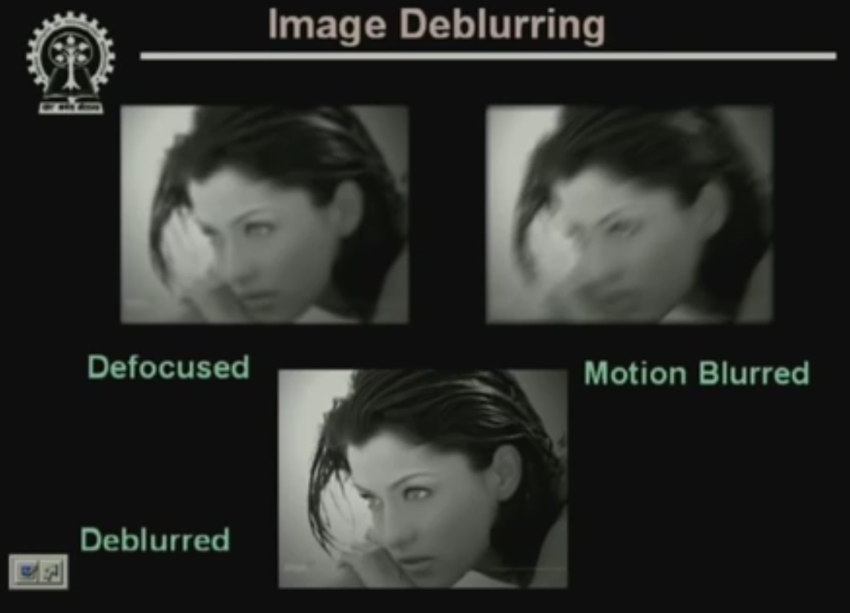

Slide 14
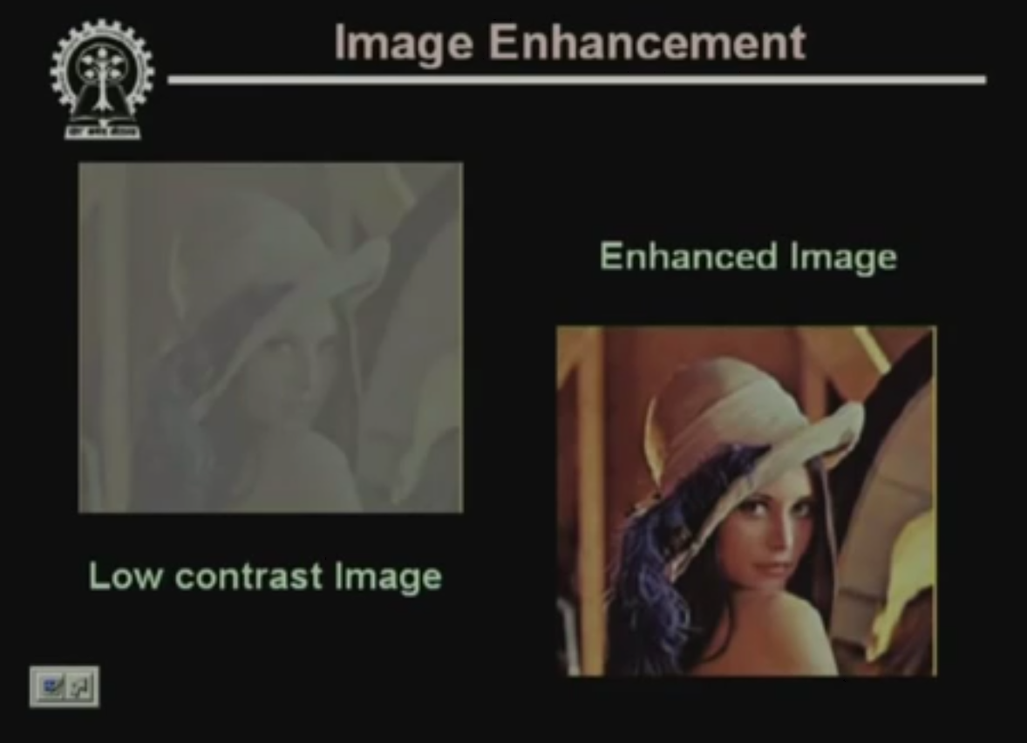

Slide 15
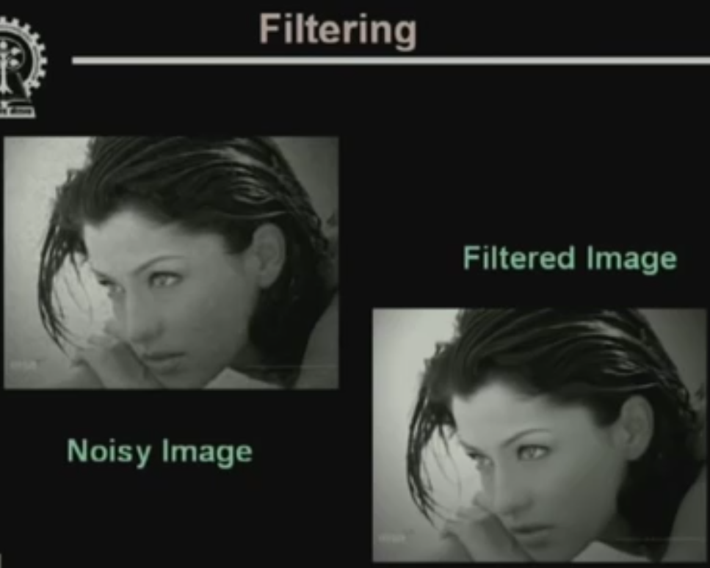

Slide 16
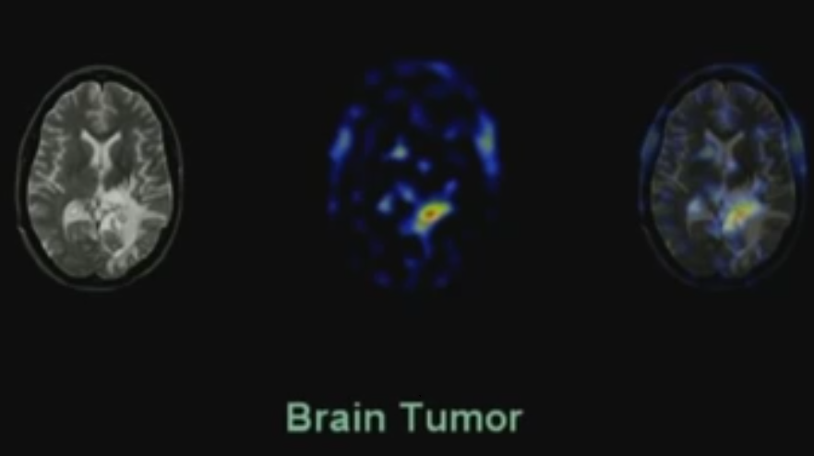
Medical Imaging

Slide 17
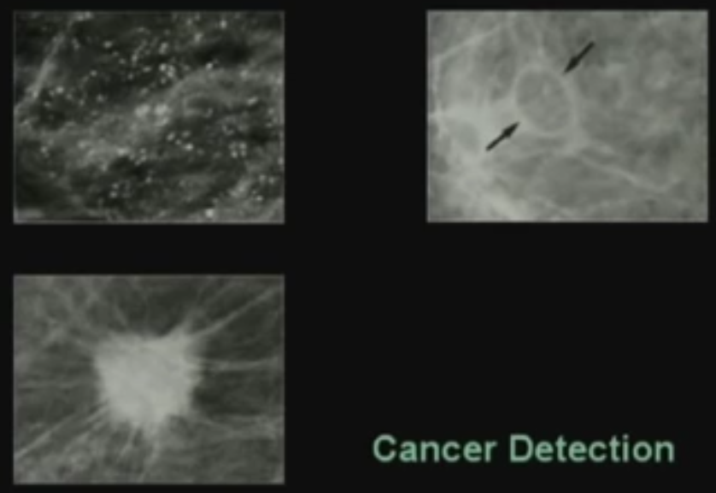

Slide 18
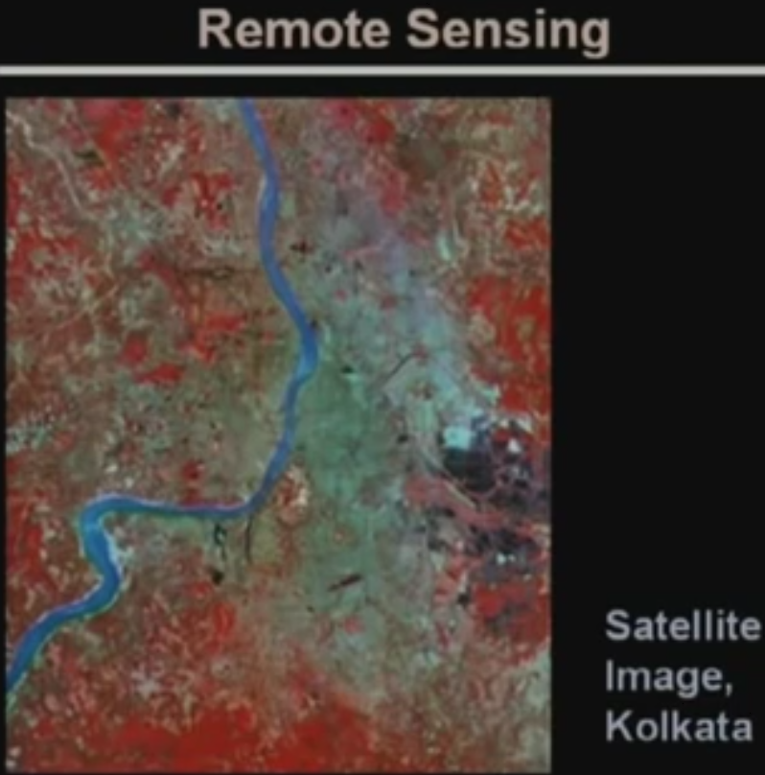

Slide 19
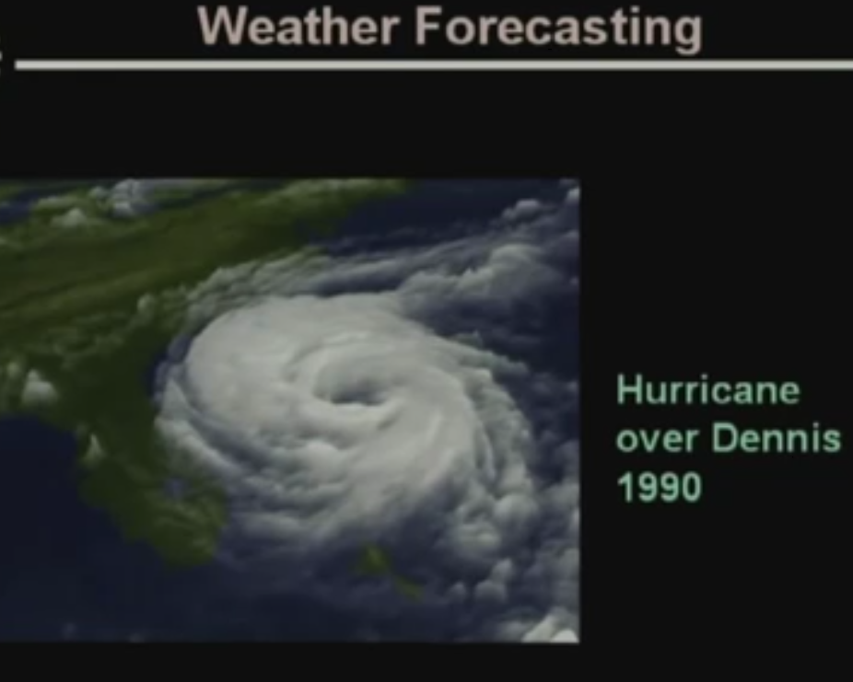

Slide 20
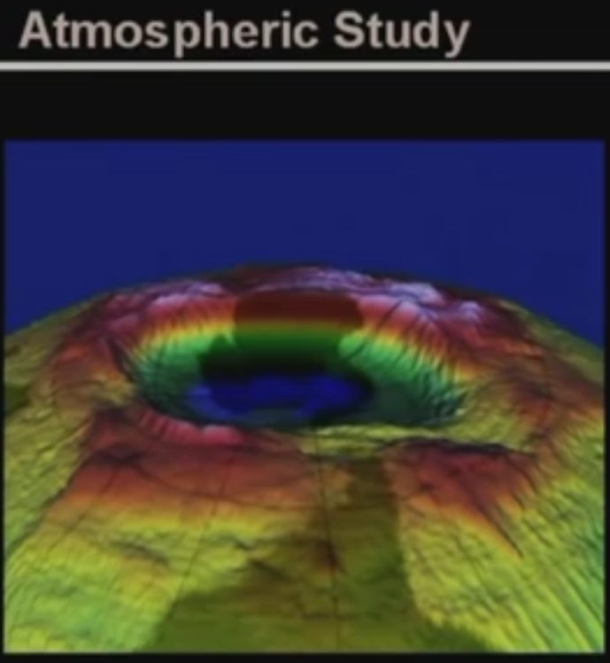


Slide 21

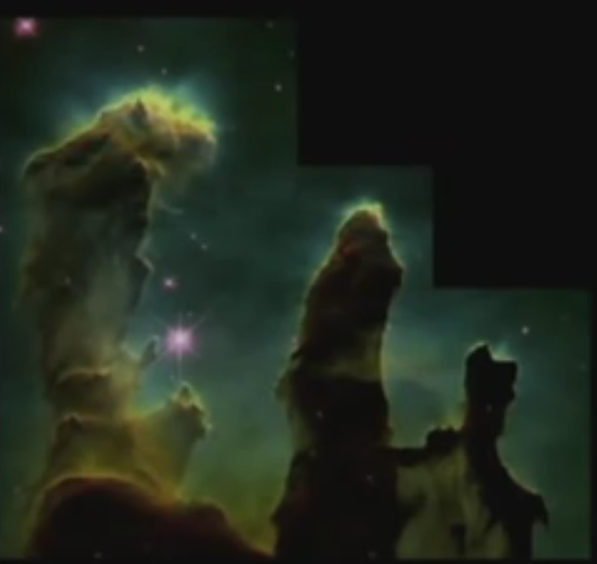


Slide 22
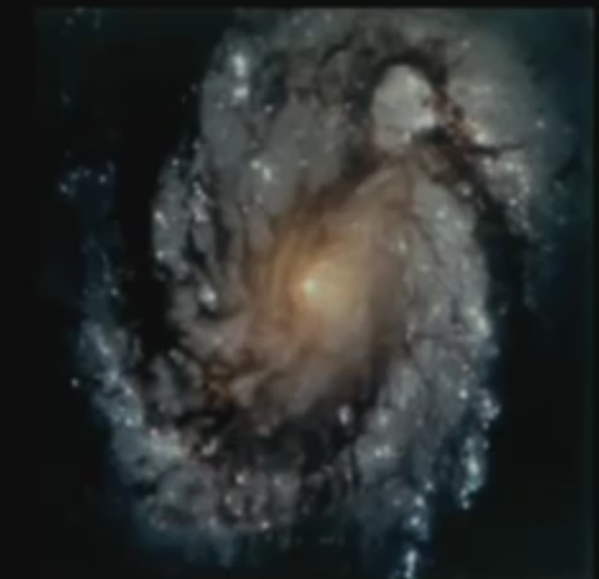


Slide 23
Machine Vision Applications
Typical Applications
Industrial Machine vision for product assembly and inspection.
Automated target detection & Tracking.
Finger print & Face Recognition.
Machine processing of aerial and satellite imaginary for weather prediction and crop assessment.

Slide 24
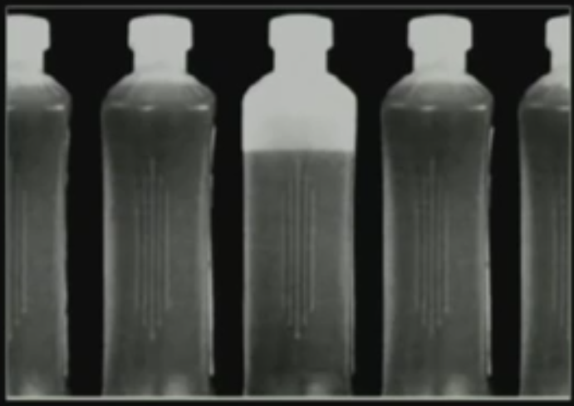


Slide 25

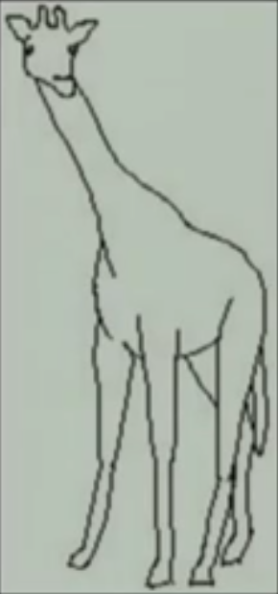

Slide 26

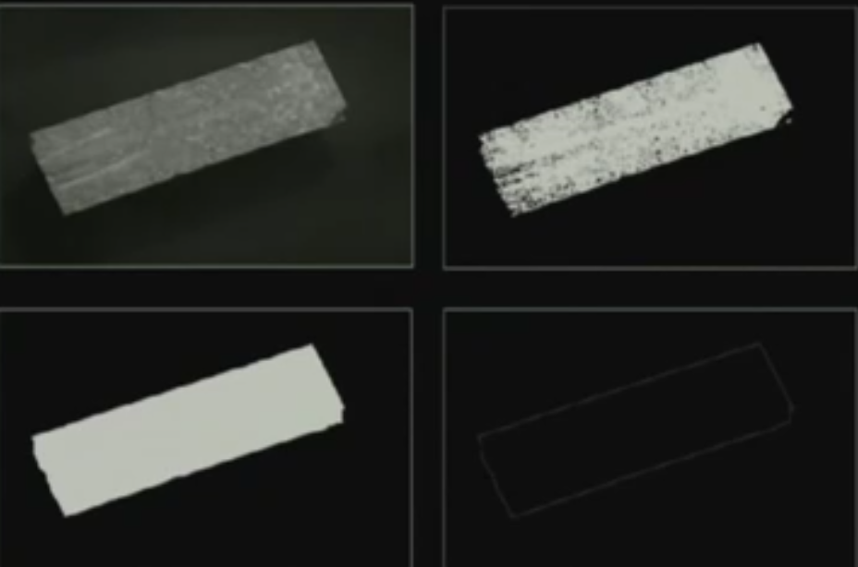

Slide 27
Video Sequence Processing
Detection and tracking of moving targets for security surveillance purpose.
To find out the trajectory of a moving target.
Monitoring the movements of organ boundaries in medical applications.
The major emphasis of image sequence processing is Detection of moving parts.

Slide 28
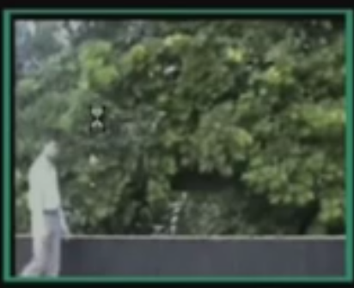
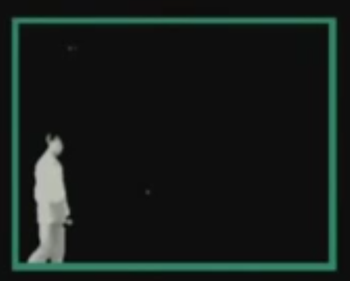

Slide 29
What is an Image?
An image is nothing more than a two dimensional signal.
It is defined by the mathematical function f(x,y) where x and y are the two co-ordinates horizontally and vertically.
The value of f(x,y) at any point is gives the pixel value at that point of an image.

Slide 30

202 | 230 | 235 | 232 | 238
205 | 225 | 230 | 234 | 239
207 | 223 | 234 | 235 | 240
211 | 224 | 230 | 237 | 238
215 | 215 | 220 | 240 | 225

Slide 31
Fundamentals
An image may be defined as a two-dimensional function, ,where x and y are spatial (plane) coordinates, and the amplitude of f, at any pair of coordinates (x, y) is called the intensity or gray level of the image at that point.
When x, y, and the intensity values f are all finite, discrete quantities, we call the image a digital image.
The field of digital image processing refers to processing digital images by means of a digital computer.
A digital image is composed of a finite number of elements, each of which has a particular location and value.
These elements are called picture elements, image elements,pels,and pixels.

Slide 32
Pixel –Fundamentals.
Pixels are arranged in rows and columns.
Pixel will occupy some area.
Every pixel will have some value.
In a binary picture, pixel will have either 0 or 1.
For a grey level picture the values will range from 0 to 255.
If it is a colour picture different values will exist.
Each pixel will have 8 bits.

Slide 33
Resolution
Pixel
Pixel is the smallest element of an image.
Each pixel correspond to any one value.
In an 8-bit gray scale image, the value of the pixel between 0 and 255.
The value of a pixel at any point correspond to the intensity of the light photons striking at that point.
Each pixel store a value proportional to the light intensity at that particular location.

Slide 34
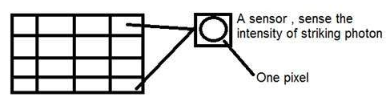
Pixel can also be defined as the smallest division the CCD array is also known as pixel.
Each division of CCD array contains the value against the intensity of the photon striking to it.
This value can also be called as a pixel.

Slide 35
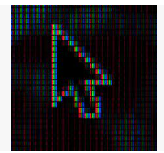
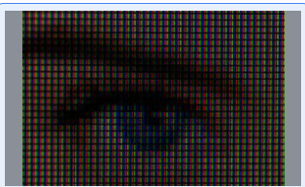

Slide 36
Calculation of total number of pixels
An image as a two dimensional signal or matrix.
Then in that case the number of PEL would be equal to the number of rows multiply with number of columns.
Total number of pixels = number of rows ( X ) number of columns.
The total number of pixels available is called Resolution.
If there are m rows and n columns then the resolution will be m x n

Slide 37
Gray level
The value of the pixel at any point denotes the intensity of image at that location, and that is also known as gray level.
Each pixel can have only one value and each value denotes the intensity of light at that point of the image.
The value 0 means absence of light. It means that 0 denotes dark, and it further means that when ever a pixel has a value of 0, it means at that point, black color would be formed.

Slide 38
Number of different colors:
The number of different colors depend on the number of bits per pixel.
ie., (2)^{bpp} , where bpp denotes bits per pixel.
Bits per pixel Number of colors
1 bpp 2 colors ( 2 levels)
2 bpp 4 colors(4 levels)
3 bpp 8 colors
4 bpp 16 colors
5 bpp 32 colors
6 bpp 64 colors
7 bpp 128 colors
8 bpp 256 colors

Slide 39
Shades
The famous gray scale image is of 8 bpp , means it has 256 different colors in it or 256 shades.
Shades = number of colors = (2)^{bpp}
Color images are usually of the 24 bpp format, or 16 bpp.
0 pixel value always denotes black color.
But there is no fixed value that denotes white color.
The value that denotes white color can be calculated as :
White color = (2)^{bpp}-1
In case of 1 bpp, 0 denotes black, and 1 denotes white.( B & W)
In case 8 bpp, 0 denotes black, and 255 denotes white.

Slide 40
Gray color:
When you calculate the black and white color value, then you can calculate the pixel value of gray color.
Gray color is actually the mid point of black and white.
In case of 8bpp, the pixel value that denotes gray color is 127 or 128bpp.
Gray color value ranges from 0 to 255.

Slide 41
Image size
The size of an image depends upon three things.
Number of rows
Number of columns
Number of bits per pixel
The formula for calculating the size is given below.
Size of an image = rows * cols * bpp
Ex: Assuming it has 1024 rows and it has 1024 columns. And since it is a gray scale image, it has 256 different shades of gray or it has bits per pixel.
Size of an image = rows * cols * bpp
= 1024 * 1024 * 8
= 8388608 bits.
Converting it into bytes = 8388608 / 8 = 1048576 bytes.
Converting into kilo bytes = 1048576 / 1024 = 1024kb.
Converting into Mega bytes = 1024 / 1024 = 1 Mb.

Slide 42
Types of Images
The binary image
The binary image as it name states, contain only two pixel values.
0 and 1.
Here 0 refers to black color and 1 refers to white color. It is also known as Monochrome.
The resulting image that is formed hence consist of only black and white color and thus can also be called as Black and White image.

Slide 43
Grayscale image
8 bit color format is one of the most famous image format.
It has 256 different shades of colors in it.
It is commonly known as Grayscale image.
The range of the colors in 8 bit vary from 0-255. Where 0 stands for black, and 255 stands for white, and 127 stands for gray color.

Slide 44
color image
color image format contains 16 bit format. It has 65,536 different colors in it.
It is also known as High color format.
A 16 bit format is divided into three further formats which are Red , Green and Blue. (RGB)

Slide 45
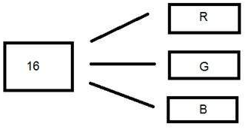
how would you distribute 16 bits into three?
So the distribution of 16 bit has been done like this.
5 bits for R, 6 bits for G, 5 bits for B.
The additional bit that was left behind is added into the green bit. Because green is the color which is most soothing to eyes in all of these three colors.

Slide 46
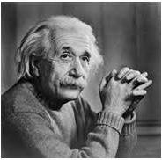


B & W
Gray color
Color Image

Slide 47
Aspect ratio
Aspect ratio is the ratio between width of an image and the height of an image.
It is commonly explained as two numbers separated by a colon (8:9).
This ratio differs in different images, and in different screens.
The common aspect ratios are:
1.33:1, 1.37:1, 1.43:1, 1.50:1, 1.56:1, 1.66:1, 1.75:1, 1.78:1, 1.85:1, 2.00:1, e.t.c

Slide 48
Advantage
Aspect ratio maintains a balance between the appearance of an image on the screen, means it maintains a ratio between horizontal and vertical pixels.
It does not let the image to get distorted when aspect ratio is increased.
Aspect ratio tells us many things. With the aspect ratio, you can calculate the dimensions of the image along with the size of the image.

Slide 49
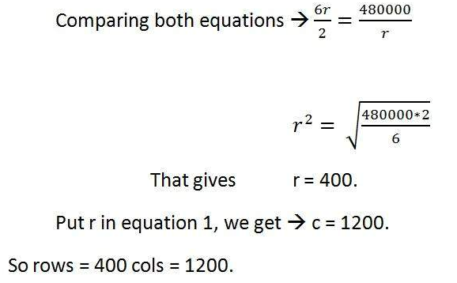
Ex: If you are given an image with aspect ratio of 6:2 of an image of pixel resolution of 480000 pixels given the image is an gray scale image.
Aspect ratio: c:r = 6:2
Pixel resolution: c * r = 480000
Bits per pixel: grayscale image = 8bpp
c :r = 6 : 2; c = 6r / 2 --------(1) c = 480000 / r -----(2)

Slide 50
Size = rows * cols * bpp
Size of image in bits = 400 * 1200 * 8 = 3840000 bits
Size of image in bytes = 480000 bytes
Size of image in kilo bytes = 48 kb (approx).

Slide 51
Image resolution:
A resolution can be defined as the total number of pixels in an image.
Sampling determines the spatial resolution of an image
Spatial resolution is smallest discernible detail in an image
Gray level resolution
Gray level resolution is the smallest discernible change in gray level.
Gray level resolution is equal to the number of bits per pixel.
Due to hardware considerations number of gray levels usually an integer power of 2 .

Slide 52
Most common number is 8 bits ,16 bits
The subsampling was accomplished by deleting the appropriate number of rows from the original image
512 *512 image obtained by deleting every other row and column from 1024*1024 image .
256 *256 image obtained by deleting every other row and column in the 512*512 image
Level of details lost in the subsampled images is simply too fine to be seen
256*256 image shows slight check board pattern
By reducing gray levels keeping spatial resolution constant 256 ,128,64 levels are visually identical for all practical purpose.
32 level image almost imperceptible , and details of the image is missing called false contouring

Slide 53
The mathematical relation that can be established between gray level resolution and bits per pixel can be given as.
L = 2^{K} In this equation L refers to number of gray levels or the shades of gray. k refers to bpp or bits per pixel.
If an image with 8 bits per pixel or 8bpp then L = 2⁸ = 256.
Gray level resolution is found on the y axis of the signal.

Slide 54
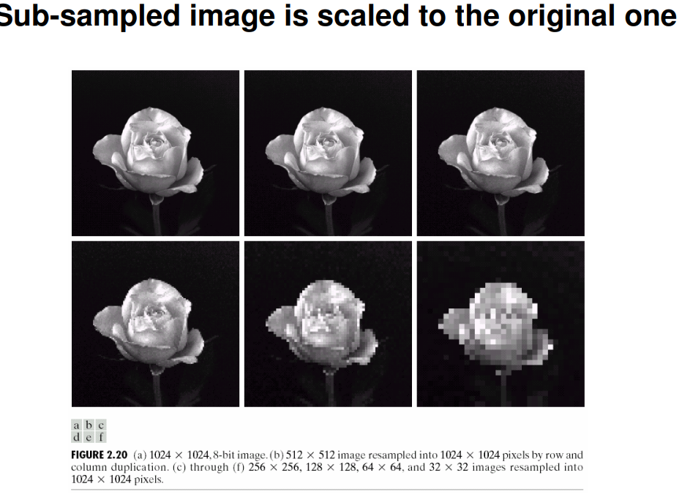
Spatial resolution

Slide 55
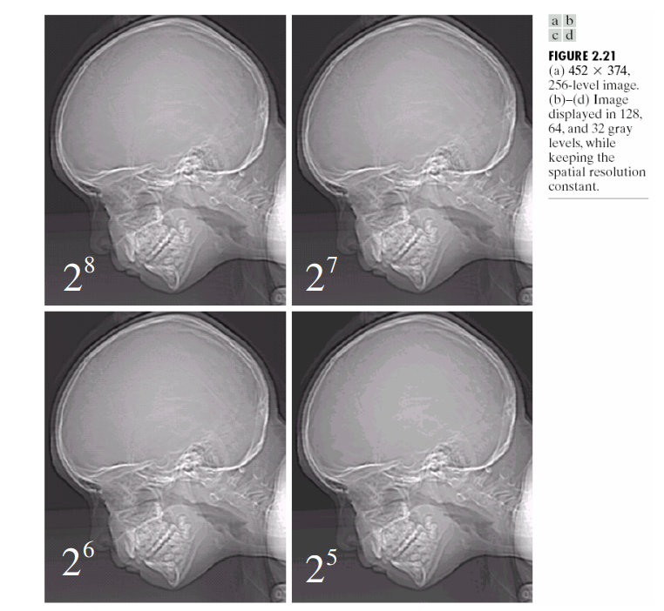
Gray level resolution

Slide 56
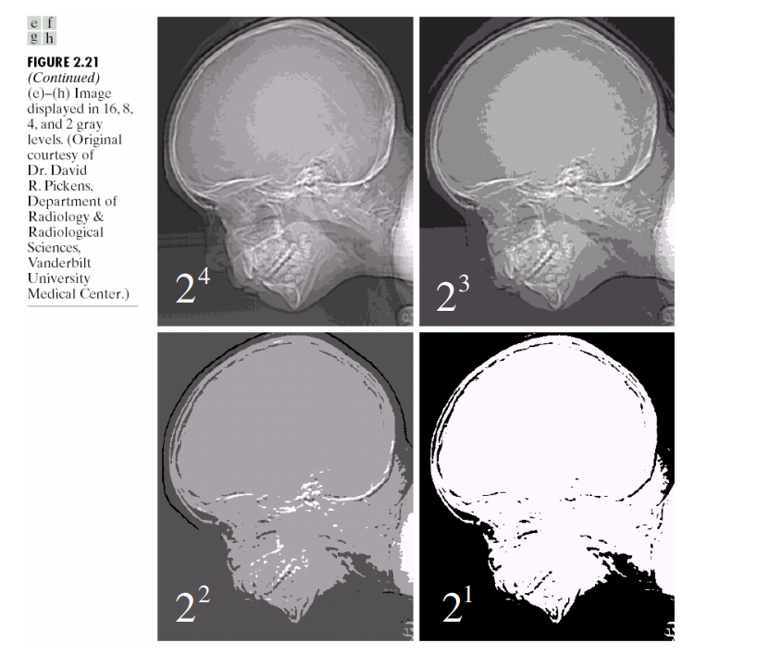
Gray level resolution

Slide 57
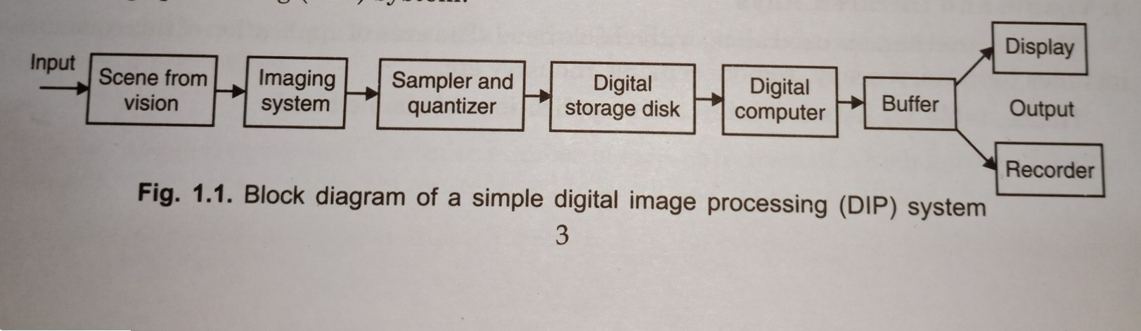
DIGITAL IMAGE PROCESSING SYSTEM

Slide 58
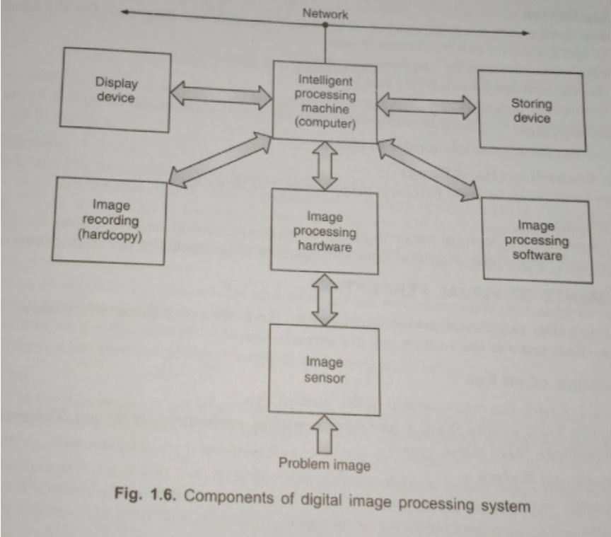

Slide 59
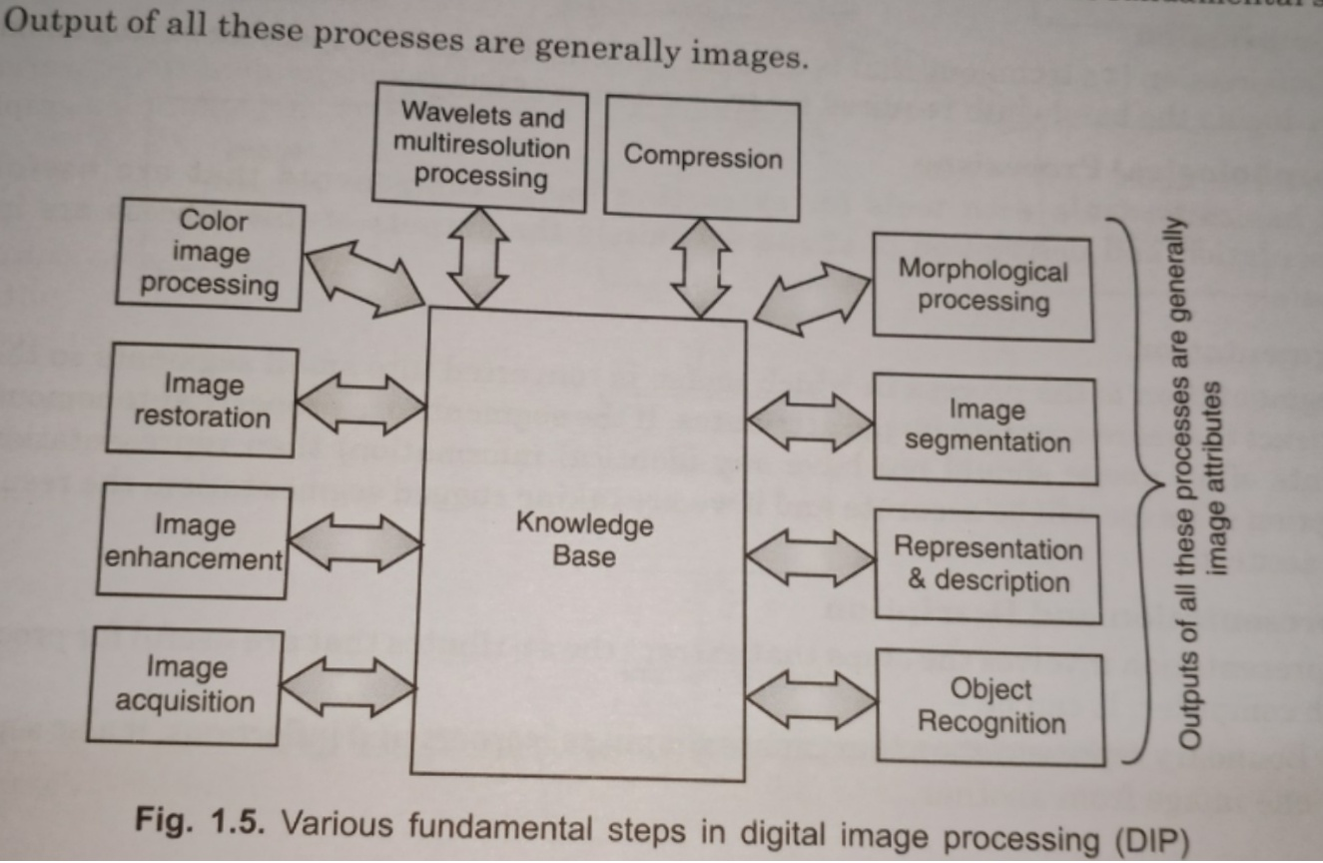

Slide 60
Image Digitization
Why do we need Digitization?
What is Digitization?
How to Digitize an Image?

Slide 61
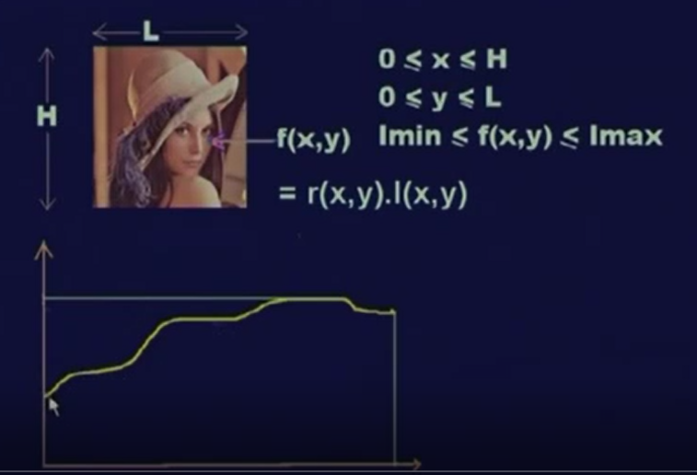

Slide 62
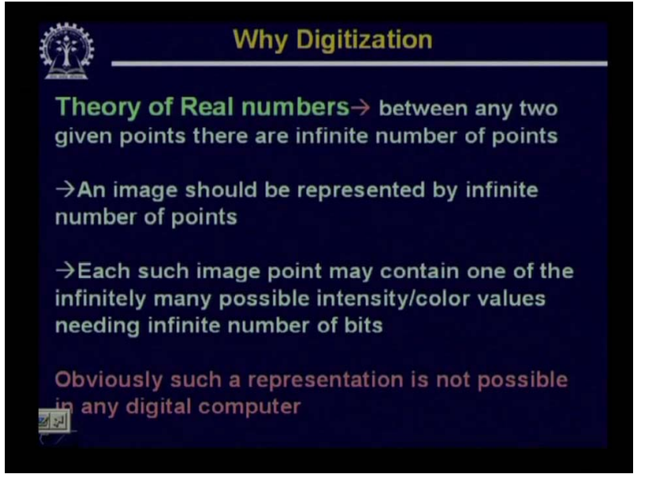

Slide 63
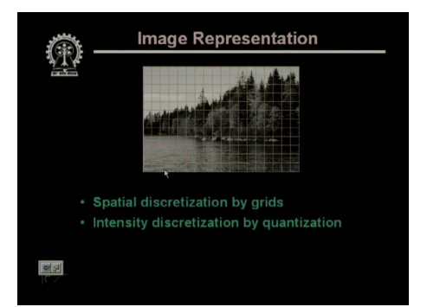

Slide 64
F(x,y) = r (x,y) * I (x,y) where
r represent the Reflection at that point and
I represent the Intensity of the light falling on the point.
r varies from 0 to 1 and I varies from 0 to infinity.
An image will represented 2-D finite matrix.

Slide 65
Theory Of Real Numbers
Between any given two points there exists infinite number of points.
Any Image is represented by Infinite number of Points.
Each such Image point may contain one of the infinitely possible intensity/colour values needing infinite number of bits.
Such representation is not possible in any digital computer.

Slide 66
An Image can be represented in the form of a finite 2-D Matrix as shown below.
F(0,0) F(0,1) F(0,2) F(0,3) …………………… f(0,N-1)
F(1,0) F(1,1) F(1,2) F(1,3) …………………… f(1,N-1)
F(2,0) F(2,1) F(2,2) F(2,3) …………………… f(2,N-1)
-- ---- --- ---- ----
-- ---- --- ---- ----
-- ---- --- ---- ----
F(M-1,0) F(M-1,1) F(M-1,2) F(M-1,3) …………………… f(M,N-1)
Each of the Matrix elements should assume one of the finite discrete values.

Slide 67
Quantization
Quantization is the process of mapping continuous infinite values to a smaller set of discrete finite values.
Quantization is involved to some degree in nearly all digital signal processing, as the process of representing a signal in digital form ordinarily involves rounding.
The difference between an input value and its quantized value (such as round-off error) is referred to as quantization error.
A device or algorithmic function that performs quantization is called a quantizer.
An analog-to-digital converter is an example of a quantizer.

Slide 68
An analog-to-digital converter (ADC) can be modelled as two processes: sampling and quantization.
Sampling converts a time-varying voltage signal into a discrete-time signal, a sequence of real numbers.
Quantization replaces each real number with an approximation from a finite set of discrete values.

Slide 69
To create a digital image, we need to convert the continuous sensed data into digital form. This process includes 2 processes:
Sampling: Digitizing the co-ordinate value is called sampling.
Quantization: Digitizing the amplitude value is called quantization.
To convert a continuous image f(x, y) into digital form, we have to sample the function in both co-ordinates and amplitude.

Slide 70
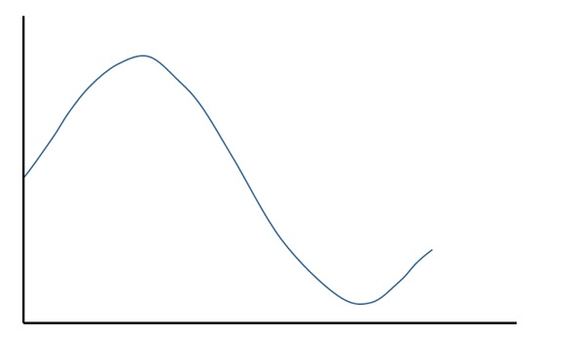
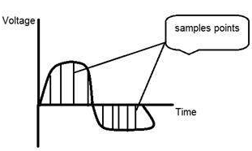
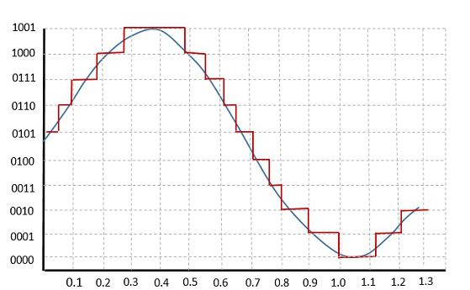
The following figure shows the resultant quantized signal
which is the digital form for the given analog signal.
Sampling

Slide 71
Sampling Quantization
Digitization of co-ordinate values
x-axis(time) – discretized.
y-axis(amplitude) – continuous.
Sampling is done prior to the quantization process.
A single amplitude value is selected from different values of the time interval to represent it.
Digitization of amplitude values.
x-axis(time) – continuous.
y-axis(amplitude) – discretized.
Quantization is done after the sampling process.
Values representing the time intervals are rounded off to create a defined set of possible amplitude values.

Slide 72
Types of Quantization
There are two types of Quantization –
Uniform Quantization and Non-uniform Quantization.
The Mid-Rise type is so called because the origin lies in the middle of a raising part of the stair-case like graph. The quantization levels in this type are even in number.
The Mid-tread type is so called because the origin lies in the middle of a tread of the stair-case like graph. The quantization levels in this type are odd in number.

Slide 73
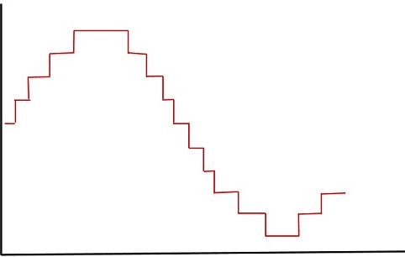
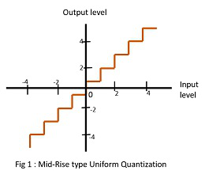
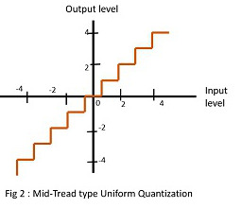

Slide 74
The Mid-Rise type is so called because the origin lies in the middle of a raising part of the stair-case like graph.
The quantization levels in this type are even in number.
The Mid-tread type is so called because the origin lies in the middle of a tread of the stair-case like graph.
The quantization levels in this type are odd in number.

Slide 75
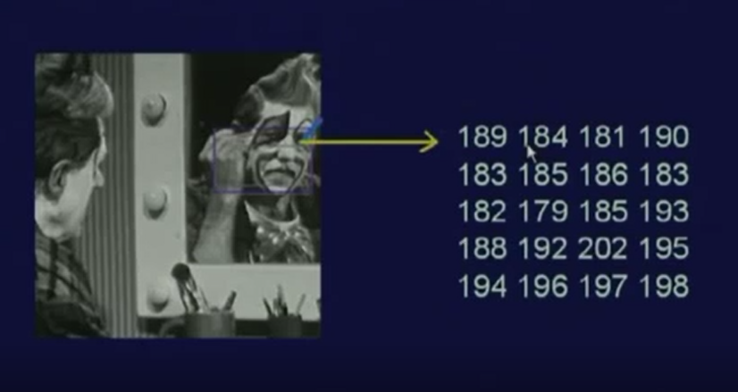
Image as Matrix of Numbers

Slide 76
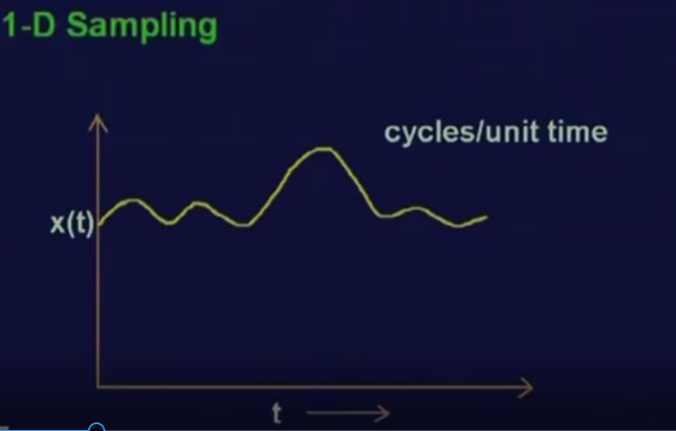

Slide 77
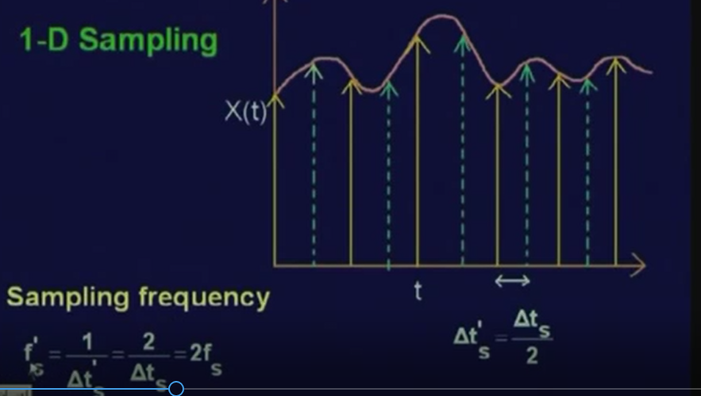

Slide 78
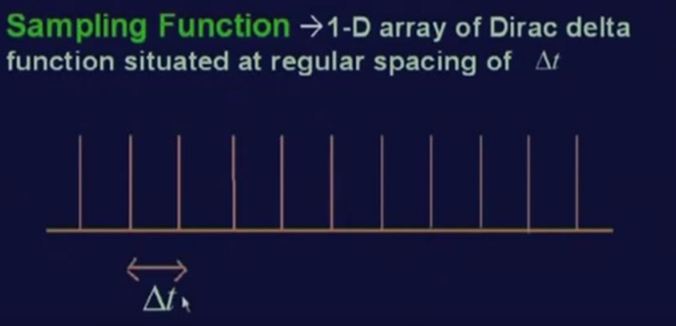

Slide 79
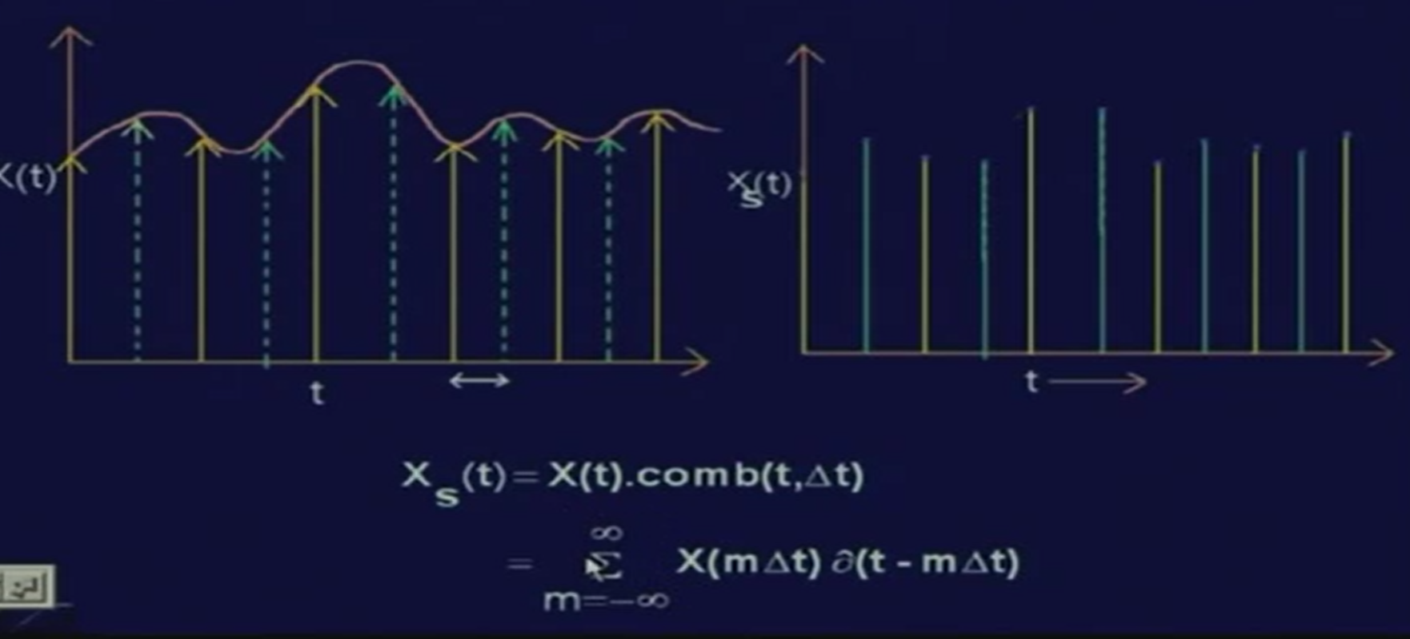

Slide 80
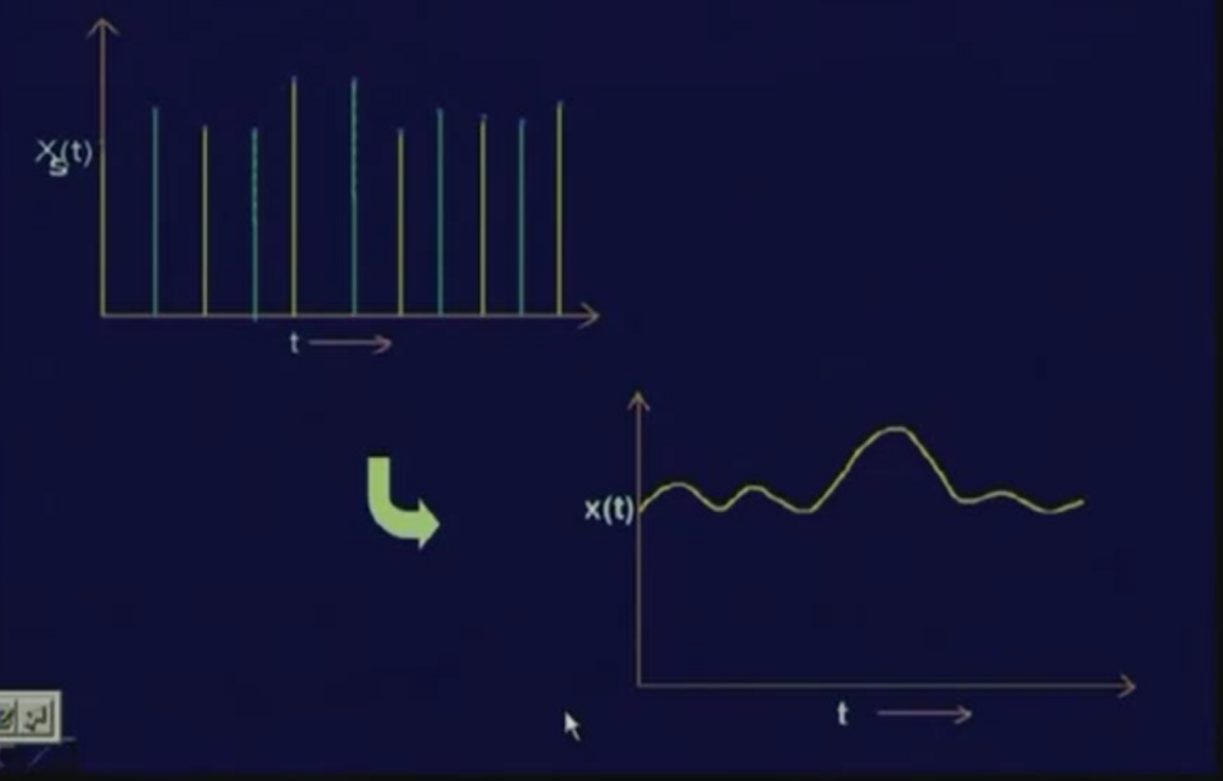

Slide 81
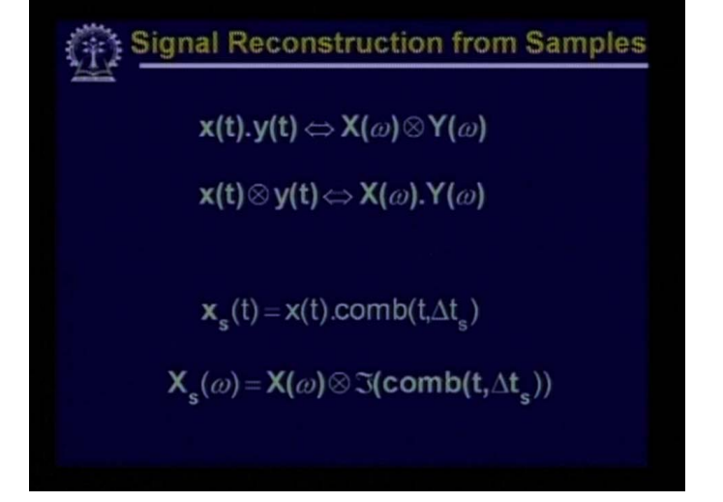

Slide 82
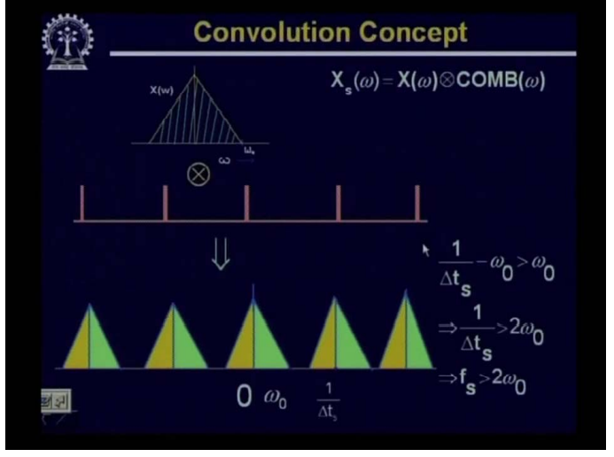

Slide 83
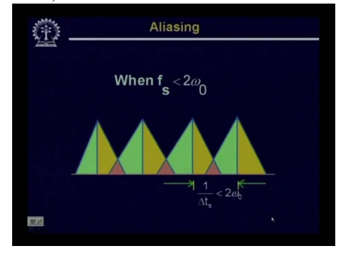

Slide 84
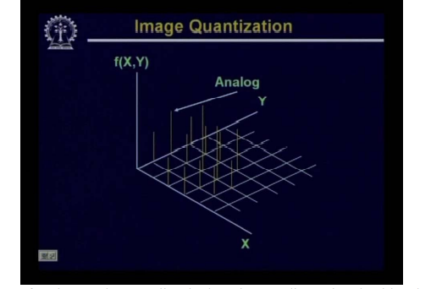

Slide 85
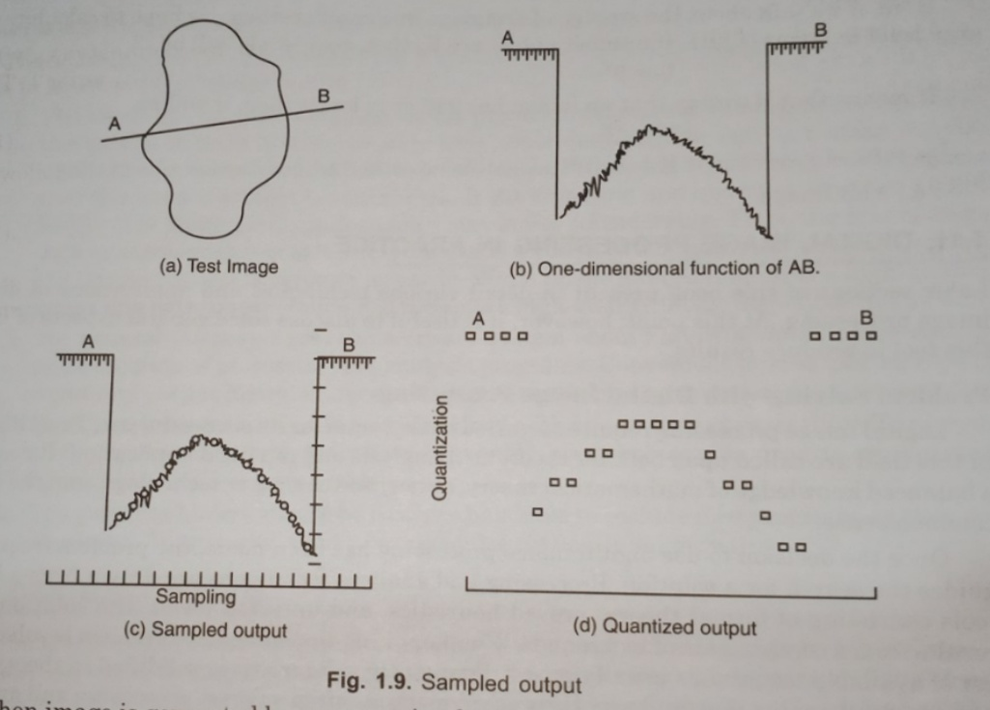

Slide 86
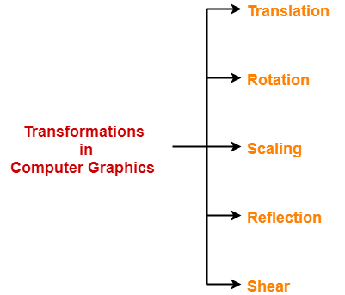
2-D Geometric Transformations
2D Transformations take place in a two-dimensional plane.
Transformations are helpful in changing the position, size, orientation, shape etc of the object.

Slide 87
Scaling
Changing the size of an image is called scaling.
To change the size of an object, scaling transformation is used. In the scaling process, you either expand or compress the dimensions of the object.
Scaling can be achieved by multiplying the original coordinates of the object with the scaling factor to get the desired result.

Slide 88
Scaling
Point is expressed as P(x,y) in 2-Dimensional.
Point also can be expressed in the form of Matrix.
X Y 1 X 2 matrix.
Multiply the point with Identity matrix.
X Y * 1 0
0 1 = x y
Results the same point.

Slide 89
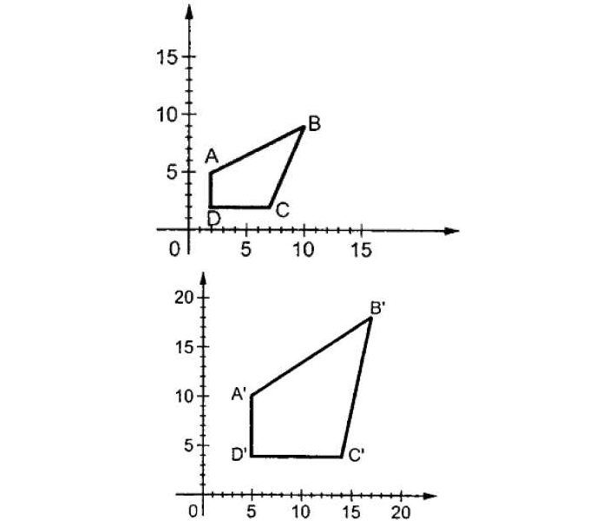
Scaling

Slide 90
SCALING
Ex. x y * 2 0 = 2x, y x- coordinate increased 2 times
0 1
2. X Y * 1 0 = x, 2y y – coordinate increased 2 times.
0 2
x y * 5 0 = 5x ,3y
0 3
x value increased by 5 times and y value increased by 3 times.

Slide 91
In general the scaling 2 x 2 transformation matrix is given by
S_{x} o
0 S_{y}
if the point is (x,y) then then after scaling the point will be
x,y * S_{x} o
0 S_{y =} x.S_{x} , y.S_{y}

Slide 92
EXCERSICE
Give a 2 x 2 matrix for the following.
Increase the image by 10 times in length and 5 times in height.
Increase the image by 15 times in length and 1/2 times in height.
Increase the image by 1/10 times in length and 10 times in height.
Increase the image by 10 times.
Increase the image by 5 times in height.
Increase the image by 20 times in length.
Increase the entire image by 1/3.

Slide 93
Rotation
Two types of rotation are possible
1. Clockwise rotation
2. anti clockwise rotation

Slide 94
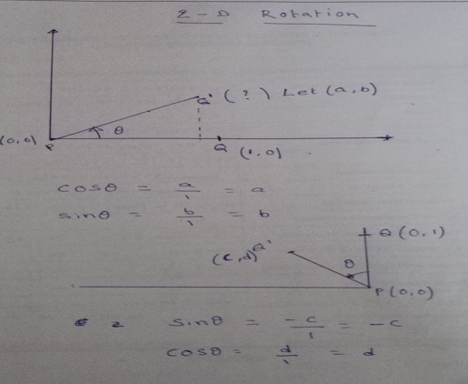

Slide 95


Slide 96

Rotation
Let us suppose you want to rotate it at the angle θ. After rotating it to a new location, you will get a new point P’ X′,Y′X′,Y′.
In rotation, we rotate the object at angle θ (theta) from its origin. From the following, figure, we can see that the point p(x,y) is located at an angle α from the horizontal X coordinate with distance r from the origin. Let us suppose we want to rotate it at the angle θα . After rotating it to a new location we will get a new point p^{I} (x^{i} ,y^{i})

Slide 97

Rotation

Slide 98

Rotation

Slide 99

Commonly used spatial coordinate transformation matrix has the general form given below

Slide 100


Slide 101

Translation

Slide 102
Translation
Moving the image or displacement of image is called Translation. The translation matrix is expressed in 3 x 3 matrix.
1 0 0
0 1 0
t_{x} t_{y} 1
The translated object is give by x+t_{x} , y+t_{y} , 1
This translation is achieved by adding the translation coordinates to the old coordinates of the object as-
X_{new} = X_{old} + T_{x} (This denotes translation towards X axis)
Y_{new} = Y_{old} + T_{y} (This denotes translation towards Y axis)

Slide 103
Translation - Exercises
Move the image by 5 units in x –direction and 3 unis in y - direction.
Move the image by 10 units in x –direction.
Move the image by 25 units in upward direction.
Move the image by 8 units downwards and 3 units right.
Move the image by 2 units upwards and 3 units left.
Consider a line A) 2,3 B) 6,3. move the line 25 units
7. Consider a triangle a) 2,3 b) 6,3 c) 6,6. Move this triangle by 10 units left and 20 units upwards and find out the translated points.

Slide 104
Scaling Rotation(Anti Clk)
Sx 0 Cos θ -Sin θ
0 Sy Sin θ Cos θ
Ex : Scale the image then Translate and rotate it.
2 x 2 * 3 x 3 * 2 x 2 ---- Not possible.
Solution : Change Scaling and Rotation in 3 x 3 form.

Slide 105
Scaling 3 x 3 Rotation 3 x 3 (anti Clock) Rotation(Clock)
S_{X} 0 0 COS θ SIN θ 0 COS θ -SIN θ 0
0 S_{Y} 0 -SIN θ COS θ 0 SIN θ COS θ 0
0 0 1 0 0 1 0 0 1
S_{X} = change in length, S_{y} = change in height
TRANSLATION
0 0
0 1 0 T_{x} = displacement in X direction
T_{X} T_{Y} 1 T_{y} = displacement in Y direction

Slide 106
Ex. Rotate the line P(3,5) to Q(8, 10) shown in the figure by 45^{θ}
Q ^{Í}
^{Q}
^{P}
^{Translate the image to origin}
^{Rotate by 45}
Translate to original place( to P)

Slide 107
Q^{I}
Q^{I} Q
Q
Q
P
Translation Rotation translation

Slide 108
1 0 0 cos 45 sin 45 0 1 0 0
0 1 0 * -sin 45 cos 45 0 * 0 1 0
-3 -5 1 0 0 1 3 5 1

Slide 109
Reflection
Reflection is the mirror image of original object.
In other words, we can say that it is a rotation operation with 180°.
In reflection transformation, the size of the object does not change.
The following figures show reflections with respect to X and Y axes, and about the origin respectively.

Slide 110


Slide 111


Slide 112
Reflections
Reflection about X –axis
1 0 0
0 -1 0
0 0 1
Reflection aboutY – axis -1 0 0
0 1 0
0 0 1

Slide 113
Reflection through y = x
0 1 0
1 0 0
0 0 1
Reflection through origin(y = -x)
0 -1 0
-1 0 0
0 0 1

Slide 114


Slide 115
Problems
1.) Consider a line p(5,8) to q(10,12) is reflected through a mirror given by y=5, parallel to x-axis. Find out the reflected view of the line through this mirror.
2.) Consider a triangle ABC is reflected through a mirror which is passing through a point (30,10) and parallel to Y-axis. Find out the reflected view of the triangle through this mirror.

Slide 116


Slide 117


Slide 118
Shear
A transformation that slants the shape of an object is called the shear transformation.
There are two shear transformations X-Shear and Y-Shear. One shifts X coordinates values and other shifts Y coordinate values.
However; in both the cases only one coordinate changes its coordinates and other preserves its values. Shearing is also termed as Skewing.

Slide 119


Slide 120


Slide 121
What is pixel neighbourhood and different types of neighbourhood.
What is meant by connectivity?
What is adjacency and different type of adjacency?
Different distance measures.

Slide 122
Neighbourhood of a Pixel
---------------------------------→y
f(x-1,y-1) f(x-1,y) f(x-1,y+1)
f(x,y-1) P(x , y) f(x,y+1)
f(x+1,y-1) f(x+1,y) f(x+1,y+1)
A pixel at location P(x,y) has two neighbourhood pixels in horizontal and vertical directions each.

Slide 123
4 - Neighbourhood of a Pixel.
This set of four pixels is called 4- Neighbours of P
= N₄(P)
Each of these neighbours is at unit distance from P.
If P is a Boundary pixel then it will have less number of neighbour pixels.

Slide 124
Neighbourhood of a Pixel.
Boundary pixel
P | X
X

Slide 125
8 - Neighbourhood of a Pixel.
f(x-1,y-1) f(x-1,y) f(x-1,y+1)
f(x,y-1) P(x,y) f(x,y+1)
f(x+1,y-1) f(x+1,y) f(x+1,y+1)

Slide 126
Connectivity
Connectivity between two pixels is a very important concept.
It is very useful
in establishing object boundaries.
defining image components/regions etc..
Two pixels are said to be connected if they are adjacent in some sense.
--- They are Neighbours( N₄,N₈ or N_{D} ) and
---- their intensity values are similar( Gray level).

Slide 127
Connectivity
For a Binary Image B, two points p and q will be connected if
p € N(q) or q € N(p) and
B(p) = B(q).
0 | 0 | 1 | 0
1 | P 1 | 1 | 0
1 | 0 | Q 1 | 1
1 | 1 | 0 | 1
0 | 0 | 1 | 0
1 | 1 | P 1 | 0
1 | q 0 | 1 | 1
1 | 1 | 0 | 1
0 | 0 | 1 | 0
P 1 | 1 | 1 | 0
q 1 | 0 | Q 1 | 1
1 | 1 | 0 | 1

Slide 128
Connectivity
Let V the set of gray levels used to define connectivity for two points
p and q € V. Three types of connectivity are defined.
1. 4 – connectivity
p, q € V and p € N₄ (q)

Slide 129


4- Connectivity

Slide 130


Slide 131
8 – connectivity
p, q € V and p € N₈ (q)
b) every 2 pixels that are adjacent in the sequence are 8-neighbors
https://www.youtube.com/watch?v=SAM4WLdCdLw

Slide 132


The Moore neighborhood (also known as the 8-neighbors or indirect neighbors)

Slide 133

CONNECTIVITY

Slide 134
m - connectivity
p, q € V are m connected if
i) q € N₄ (p) or
ii) q € N_{D} (p) and N₄ (p) ∩N₄ (q) = Ⴔᶲ
the m – connectivity is a modification of 8 – connectivity.
eliminates multiple path connections that are often arise wit 8 –connectivity.

Slide 135
M-connectivity
Either you have 4 – neighbors of P
N₄ (P) indicates the set of points which are 4 – neighbors of both the points p & q
or
Neighbors of Diagonal of P and
This says that if the point q belongs diagonal neighbor of p and there is a common set of points which are 4-neighbors of both the points of p, q then m-connectivity is not possible.

Slide 136


Slide 137
0 | 0 | 1
0 | 1 | 0
0 | 1 | 1
0 | 0 | 1
0 | 1 | 0
0 | 1 | 1
0 | 0 | 1
0 | 1 | 0
0 | 1 | 1
4 –connectivity 8 – connectivity m-connectivity for v =1

Slide 138
4-Connectivity 8-Connectivity v =(1) V= (0)
1 | 0 | 1 | 0 | 1
1 | 1 | 0 | 1 | 1
0 | .0 | 1 | 0 | 1
1 | 1 | 1 | 0 | 1
1 | 0 | 0 | 1 | 1
1 | 0 | 1 | 0 | 1
1 | 1 | 0 | 1 | 1
0 | 0 | 1 | 0 | 1
1 | 0 | 0 | 0 | 0
1 | 0 | 0 | 1 | 1
1 | 0 | 1 | 0 | 1
1 | 1 | 0 | 1 | 1
0 | .0 | 1 | 0 | 1
1 | 1 | 1 | 0 | 1
1 | 0 | 0 | 1 | 1

Slide 139
Ex : 4 – Connectivity V = 1
Ex : 4 – Connectivity V = 0
0 | 1 | 0 | 1 | 0
1 | 0 | 1 | 1 | 0
1 | 1 | 1 | 0 | 0
1 | 0 | 0 | 1 | 1
1 | 1 | 1 | 1 | 1 | 1
1 | 0 | 1 | 0 | 1 | 1
0 | 1 | 1 | 1 | 1 | 0
0 | 0 | 1 | 1 | 0 | 0

Slide 140
8 - connectivity
5 | 4 | 5 | 5 | 4
4 | 4 | 4 | 5 | 5
4 | 4 | 5 | 5 | 5
5 | 5 | 4 | 4 | 5
5 | 5 | 5 | 5 | 5
8 | 10 | 10 | 10 | 8
8 | 10 | 10 | 10 | 8
05 | 05 | 10 | 05 | 05
08 | 10 | 10 | 10 | 08
Ex : 8 –connectivity { V = 4 } Ex : * -connectivity {V = 10 }

Slide 141
M-Connectivity
0 | 0 | 1 | 0
1 | 0 | 1 | 1
0 | 1 | 1 | 1
0 | 1 | 0 | 0

Slide 142

Let p and q be as shown in Fig above
S1 and S2 are not 4-connected because q is not in the set N4(p);
(b) S1 and S2 are 8-connected because q is in the set N8(p);
(c) S1 and S2 are m-connected because (i) q is in ND (p), and
(ii) the set N4(p) ∩ N4(q) is empty.

Slide 143

When V = {0,1}, 4-path does not exist between p and q because it is impossible to get from p to q by traveling along points that are both 4-adjacent and also have values from V .
The shortest 8-path is shown in Fig. (b) above ; its length is 4.
The length of the shortest m- path (shown dashed) is 5. Both of these shortest paths are unique in this case
C)One possibility for the shortest 4-path when V = {1,2} is shown in Fig. above(c); its length is 6. It is easily verified that another 4-path of the same length exists between p and q.
One possibility for the shortest 8-path (it is not unique) is shown in Fig. above(d); its length is 4.
The length of a shortest m-path (shown dashed) is 6. This path is not unique.

Slide 144
ADJACENCY
If there are two image subsets S_{i} and S_{j} , then we can say they are adjacent if there exists a point ‘p’ in image region S_{i} and a point ‘q’ in image region S_{j} such that p and q are adjacent.
Depends on connectivity used Adjacency is classified
- 4- adjacency
--- 8 – adjacency and
--- m – adjacency.

Slide 145

ADJACENCY

Slide 146
Consider the below Gray scale Image.
100 | 200 | 225 | 250 | 230
125 | 150 | 175 | 100 | 125
100 | 95 | 85 | 90 | 100
110 | 90 | 100 | 80 | 75
125 | 135 | 110 | 115 | 125
4- Neighbours (only horizontal & vertical N₄(p) ={ 90,80,85110}
95 | 85 | 90
90 | 100 | 80
135 | 110 | 115
100 | 200 | 225 | 250 | 230
125 | 150 | 175 | 100 | 125
100 | 95 | 85 | 90 | 100
110 | 90 | 100 | 80 | 75
125 | 135 | 110 | 115 | 125
D-diagonal N_{D}(p) ={150,100,90,80}
150 | 175 | 100
95 | 85 | 90
90 | 100 | 80

Slide 147
100 | 200 | 225 | 250 | 230
125 | 150 | 175 | 100 | 125
100 | 95 | 85 | 90 | 100
110 | 90 | 100 | 80 | 75
125 | 135 | 110 | 115 | 125
8- Neighbours N₈(P) = {90,80,85110, 150,100,90,80}

Slide 148
Ex : Find out if p & q are 4 –adjacent if V ={0,1}
Condition 1 both p & q are from the set V
N₄ (p) = { 1,1,1,0}
so q is in the set of N₄ (p).
So p , q are 4 –adjacent.
0 | 1 | 1 | 0 | 1
1 | 0 | 0 | 1 | 1
0 | 1q | 1p | 1 | 0
1 | 1 | 1 | 1 | 0
0 | 0 | 1 | 1 | 0
0 | 1 | 1 | 0 | 1
1 | 0 q | 0 | 1 | 1
0 | 1 | 1 p | 1 | 0
1 | 1 | 1 | 1 | 0
0 | 0 | 1 | 1 | 0
Condition 1 both p & q are from the set V
N₄ (p) = { 1,1,1,0}
But q is not in N₄ (p).
Hence p , q are not 4 –adjacent

Slide 149
0 | 1 | 1 | 0 | 2
2 | 0 | 0 | 1 q | 1
0 | 1 | 2 p | 1 | 0
2 | 1 | 1 | 1 | 0
0 | 0 | 2 | 2 | 0
8- Adjancy
Find out if p & q are 8 –adjacent if V ={2,1}
Condition 1 both p & q are from the set V
N₈ (p) = { 0,0,1,1,1,1,1,1}
q is in the set of N₈ (p). So p , q are 8 –adjacent.
0 | 1 | 1 | 0 | 2
2 | 0 | 0 | 1 | 1
0 | 1 | 2 p | 1 | 0
2 | 1 | 1 | 1 | 0
0 | 0 q | 2 | 2 | 0
Find out if p & q are 8 –adjacent if V ={2,0}
Condition 1 both p & q are from the set V
N₈ (p) = { 0,0,1,1,1,1,1,1}
q is not in the set of N₈ (p). So p , q are not 8 –adjacent.

Slide 150
0 | 1 | 1 | 0 | 2
2 | 0 | 0 | 1 q | 1
0 | 1 | 2 p | 1 | 0
2 | 1 | 1 | 1 | 0
0 | 0 | 2 | 2 | 0
Find out if p & q are 8 –adjacent if V ={2,0}
Condition 1. both p & q are not from the set V
So p , q are not 8 –adjacent.

Slide 151
M- Adjacency
0 | 1 | 1 | 0 | 1
1 | 0 | 0 | 1 | 1
0 | 1 | 1p | 1 q | 0
1 | 1 | 1 | 1 | 0
0 | 0 | 1 | 1 | 0
i) q € N₄ (p) or
ii) q € N_{D} (p) and N₄ (p) ∩N₄ (q) = Ⴔᶲ
Find out m –adjacency for V = {1}
i) Since q € N₄ (p), m – adjacency is possible.
Find out m –adjacency for V = {1}
q € N₄ (p)
q is not in N₄(p) or
ii) q € N_{D} (p) and N₄ (p) ∩N₄ (q) = Ⴔᶲ
N_{D} (p) ={ 0,1,1,1} q is in N_{D} (p) and
N₄ (p) ∩N₄ (q) = Ⴔᶲ ,
The intersection of the above {0,1}. Since the set V contain the value 1 , we can say the M- adjacency is not possible or it’s not m-adjency.
0 | 1 | 1 | 0 | 1
1 | 0 | 0 | 1 q | 1
0 | 1 | 1p | 1 | 0
1 | 1 | 1 | 1 | 0
0 | 0 | 1 | 1 | 0
intersection
0 | 1 q
1 p | 1

Slide 152
Find out m –adjacency for V = {0}
i) Since q € N₄ (p), it’s not m – adjacency .
ii) q € N_{D} (p) and N₄ (p) ∩N₄ (q) = Ⴔᶲ
N_{D} (p) = {0,1,1,1), q € N_{D} (p)
N₄ (p) ∩N₄ (q) = Ⴔᶲ ,
Since N₄ (p) ∩N₄ (q) {1,1} not belong to set v,
it is m –adjacency.
0 | 1 | 1 | 0 | 1
1 | 0 q | 1 | 1 | 1
0 | 1 | 0 p | 1 | 0
1 | 1 | 1 | 1 | 0
0 | 0 | 1 | 1 | 0
0 | 1
1 | 0

Slide 153

LENGTH OF THE PATH

Slide 154

CONNECTED COMPONENT

Slide 155

CONNECTED COMPONENT

Slide 156

ALGORITHM FOR LABELING

Slide 157

CONNECTED COMPONENT LABELING

Slide 158

STEPS

Slide 159


Slide 160


Slide 161


Slide 162


Slide 163


Slide 164


Slide 165


Slide 166
Distance Measures
If we know two points we can find out the distance between the points using D(p , q) = [(x-s)² + (y-t)² ]^{1/2}
if the points are p(x,y) and q(s ,t )
In digital domain apart from this distance , some more distance functions are available
They are
Euclidean distance i.e. ‘De’-distance
City block distance or ‘D₄’-distance
Chess board distance or ‘D₈’- distance
Dm distance

Slide 167


Slide 168
Different types of Distances Measures:
i)Euclidean distance i.e. ‘De’-distance
De (p, q) =
ii)City block distance or ‘D₄’-distance
D₄ (p, q) = ⎢x₂ – x₁⎢+ ⎢y₂ – y₁|
iii)Chess board distance or ‘D₈’- distance
D₈ (p, q) =max (⎢x₂ – x₁⎢, ⎢y₂ – y₁⎢)
For Euclidean distance measure ,pixels having a distance less than (or) equal to some value ‘r’ from (x,y) are the points contained in a disk of radius r centered at (x,y)

Slide 169
The pixels having City block distance from (x,y) less than (or) equal to some value r, form a diamond centered at x,y
In Chess board distance the pixels with distance less than equal to r from (x,y), form a square centered at (x,y)

Slide 170


Slide 171


Slide 172


Slide 173
Note1:- In the case of pixels having a ‘D₄’ distance from (x, y) less than or equal to some value ‘r’, form a diamond, centered at (x, y).
Ex:- The pixels with D₄ distance ≤ 2 from (x, y) is shown below.
2
2 1 2
2 1 0 1 2
2 1 2
2

Slide 174
Note2:- In the case of pixels with ‘D₈’ distance from (x, y) less than or equal to some value ‘r’ forms a square, centered at (x, y).
Ex:- the Pixels with D₈ distance ≤ 2 from (x, y) is shown below
2 2 2 2 2
2 1 1 1 2
2 1 0 1 2
2 1 1 1 2
2 2 2 2 2

Slide 175


Slide 176


Slide 177


Slide 178


Slide 179


Slide 180


Slide 181


Slide 182

Compute the distance between the two pixels using the three distances : q: (1, 1) P: (2, 2)
1.Euclidian distance : ((1 -2)2+(1 -2)^{1/2} = sqrt(2).
2. D 4(City Block distance): |1 -2| +|1 -2| =2
D 8(chessboard distance ) :
max(|1 -2|, |1 -2|)= 1

Slide 183
An image segment is shown below. Let V be the set of grey levels used to define connectivity in the image. Compute D₄ , D₈ and D_{m} distance between pixel p and q for i) v =[2,3] ii) v = [2,6]
2 | 3 | 2 | 6 | 1
6 | 2 | 3 | 6 | 2
5 | 3 | 2 | 3 | 5
2 | 4 | 3 | 5 | 2
4 | 5 | 2 | 3 | 6

Slide 184
I . D₄ and D₈ will not depend on grey values.
2.Only D_{m} distance will depend on Grey values.
3. D₄ distance(city block distance) = |x-s| + |y-t| where P(x,y) Q(s,t).
= |0-4| +|0- 4| = 4+4 = 8
4. D₈ distance(chess board distance) =MAX [ |x-s| . |y-t| ]
= MAX [ |0-4| , |0-4| ]
= MAX [4,4] = 4
https://slidetodoc.com/image-processing-chapter3-part-1-relationships-between-pixels/

Slide 185
An image segment is shown below. Let V be the set of grey levels used to define connectivity in the image. Compute D₄ , D₈ and D_{m} distance between pixel p and q for i) v =[4,6] ii) v = [3,6]
5 | 4 | 4 | 3 | 4 | 2
4 | 6 | 6 | 6 | 3 | 5
6 | 3 | 8 | 5 | 4 | 4
7 | 8 | 6 | 4 | 6 | 3
5 | 3 | 5 | 7 | 5 | 6

Slide 186
Different Mathematical Tools used in Digital Image Processing
Array Vs Matrix Operations
Linear Vs Nonlinear Operations
Arithmetic Operations
Set and Logical Operations
Spatial Operations(Single-pixel Operation,
Neighborhood Operation and
Geometric Spatial Transformations)
Vector and Matrix Operations
Image Transforms
Probabilistic Methods

Slide 187
Array Vs Matrix Operations:
An array operation involving one or more images is carried out on a pixel- by- pixel basis.
√
×

Slide 188
Linear Vs Nonlinear Operations
Let H be an operator whose input and output are images. H is said to be a linear operator if, for any two images f and g and any two scalars
a and b,

Slide 189
Sum operator(i.e. H): Consider the following two images f and g. Let a is 1 and b is -1.
LHS:
RHS:

Slide 190
Max operator(i.e. H): Consider the following two images f and g. Let a is 1 and b is -1.
LHS:
RHS:

Slide 191
Arithmetic Operations:
The four arithmetic operations are denoted as:
Note that the both the images f and g must of the same size.

Slide 192
Points to remember in arithmetic operations :
If the result is a floating point number, round off its value.
If the result is above to the pixel range, consider the Maximum range value.
If the result is below to the pixel range, consider the Minimum rage value.
If the result is infinity, consider the value as Zero.

Slide 193
Addition
Image A Image B
100 105 120 200 120 80 255 225 200
90 80 75 70 100 90 = 160 180 165
60 70 65 50 55 60 110 125 125

Slide 194
Subtraction (A-B)
Image A Image B
100 105 120 200 90 80 100 15 40
90 80 75 70 60 90 = 20 20 0
60 70 65 50 55 60 10 15 05
Multiplication (A x B)
10 05 02 20 15 25 200 75 50
20 15 10 30 10 30 = 255 150 255
08 06 05 40 45 50 255 255 250

Slide 195
Division (A B)
Image A Image B
20 30 40 10 5 5 2 6 8
100 90 80 25 20 15 = 4 5 5
10 25 0 0 2 5 0 13 0

Slide 196
Set and Logical Operations
Basic Set Operations
Logical Operations

Slide 197
Basic Set Operations
When dealing with gray-scale images, the preceding concepts are not applicable, because we have to specify the intensities of all the pixels resulting form a set operation.
The union is define ad max operation,
The intersection is defined as the min. operation,
The complement is defined as the pairwise difference between a constant and the intensity of every pixel in an image.

Slide 198
6 7 4
6 7 5
1 5 7
1 2 2
4 7 0
0 1 4

Slide 199
Complement operation
254 253 251
249 248 250
255 254 251
Consider constant is 255

Slide 200
Logical Operations
AND
1 0 0 1 1 1 1 0 0
0 1 1 0 0 1 = 0 0 1
0 1 0 1 0 1 0 0 0

Slide 201
OR Operation
1 0 0 1 1 1 1 1 1
0 1 1 0 0 1 = 0 1 1
0 1 0 1 0 0 1 1 0
NOT operation
1 0 0 0 1 1
0 1 1 = 1 0 0
0 0 1 1 1 0

Slide 202
Fourier transform
Discrete domain
X(k) = ∑ x(n) e ^{–j (2∏)} nk
Inverse F.T
X(n) = ∑ x(k) e ^{j (2∏)} nk
N-1
n
N =0
N-1
n
K=0

Slide 203
Discrete Domain X(n), where n is the samples for the signal X.
N is the number of samples that we are taking for the Fourier transform.
From the discrete time signal we will get discrete frequencies of signal. (F T)
From the discrete frequencies we can obtain original discrete time signal back. (I F T)

Slide 204


Slide 205


Slide 206


The formula for 2 dimensional discrete Fourier transform is given below.
The discrete Fourier transform is actually the sampled Fourier transform, so it contains some samples that denotes an image.
In the above formula f(x,y) denotes the image, and F(u,v) denotes the discrete Fourier transform.
The formula for 2 dimensional inverse discrete Fourier transform is given below.
The inverse discrete Fourier transform converts the Fourier transform back to the image

Slide 207


Slide 208


Slide 209


Slide 210


Slide 211


Slide 212
REVIEW QUESTIONS
Block diagram of Digital, image processing.
What is meant by Digitization & sampling in digital image processing.
Different types of connectivity and adjacency - problems
2-D transformations - scaling, reflection, translation -problems
Applications of Image processing.
Resolution, Aspect ratio and problems
Distance measure – problem
Mathematical operations, logical operations, set operations – problems
Fourier transformations.

